Slide 1
Threatened Loggerhead Population Trends in Georgia: How the numbers are influenced by predation, anthropogenic impacts & climate change LTER SchoolYard Case Study

Slide 2
What do you observe & infer?

Slide 3
Sea Turtle Nest Predation & Protection
http://seaturtleexploration.com/explore-and-learn/sea-turtle-web-lessons/protecting-the-nest/

Slide 4
Locating a nest by looking for “crawls”

Slide 5
Probing for the nest cavity.

Slide 6
Loggerhead Sea Turtle Egg

Slide 7
Nest Excavation & Relocation
Some nests will be moved upland to avoid drowning of nests by tidal and current movement and other human/wildlife interactions.

Slide 8
130 eggs were counted and relocated about 10 feet upland.
Data collected will be used to determine best practice in managing nesting populations in Georgia.

Slide 9
A new nest is measured and excavated near the dunes.

Slide 10
Maternal DNA is collected

Slide 11
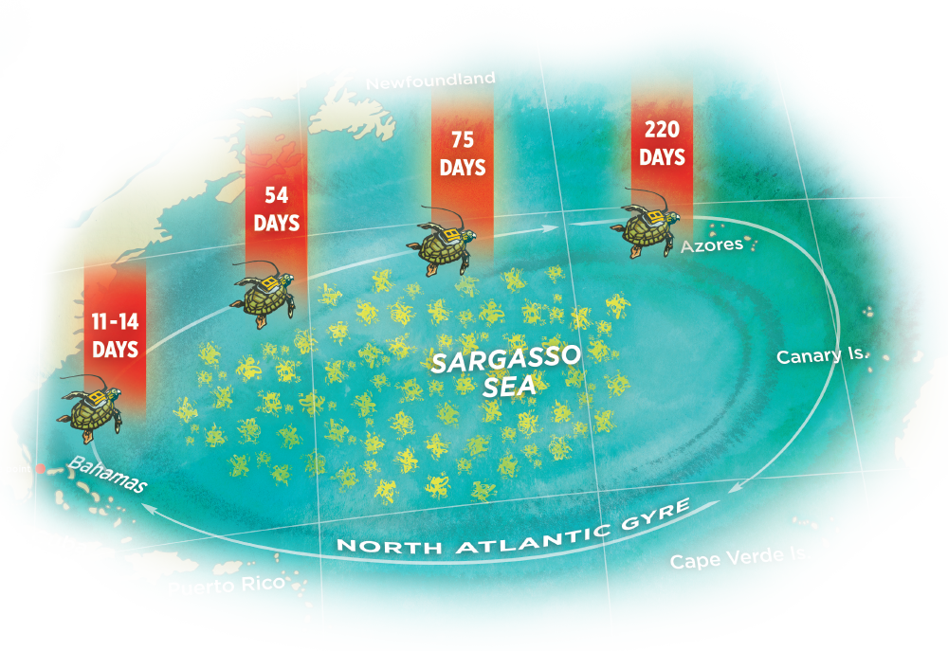
Hatchlings will emerge in about 55 days and head for refuge in ocean sargassum mats
Image: Pegasus: University of Central Florida
https://www.ucf.edu/pegasus/sea-turtles-the-lost-years/

